Slide 1
TweetCaster: Predicting Pandemic Trend from Tweets
Rachit Bhargava, Junyan Mao, Pratik Nallamotu

Slide 2
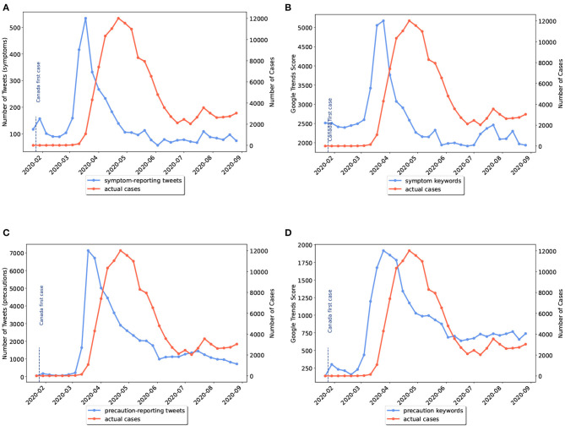
Introduction
COVID-19
48.1M total cases | 5.22M total deaths (as of 12/02/2021 in the U.S.)
Omicron :(
It’s important for health professionals to predict the trend of the pandemic!
Twitter
800M tweets/day
High correlation between COVID-related tweet volume and COVID-19 cases.
Source: Prediction of COVID-19 Waves Using Social Media and Google Search: A Case Study of the US and Canada

Slide 3
Related Work
Multiple studies and researches on approaches to evaluate emerging health crises
Using symptom related tweets to predict COVID-19 spikes.
University College London and University Guleph
Both analyzed features within Twitter datasets to identify anomalies within symptom related tweets to predict next wave of COVID
Some papers were limited by the period in which they conducted their research
Not enough data

Slide 4
Data Preparation
COVID-19 Twitter Chatter Dataset (Panacea Lab)
Using data from March 01, 2021 to August 22, 2021
Only has place_id
Tweepy
Hydration with text, and other metadata
Text pre-processing
Remove Twitter-specific patterns using regular expression. (hyperlinks, @ mentions, retweets, etc.)

Slide 5
Proposed Approach

Slide 6
Sentiment Analysis
Refers to taking a piece of text and labeling it’s sentiment as positive, neutral, or negative
Wanted to observe whether user sentiment through tweets impacted prediction of new cases
Added three features relating to sentiment analysis to input dataset
TextBlob library:
Polarity
Subjectivity
Intensity

Slide 7
Tweet Vectorization (Encoding/Embedding)
Intuition: in order for computers to learn text information, we have to convert text into a machine-interpretable form - vectors
Tokenization:
Natural Language Toolkit (NLTK): TweetTokenizer
Transformers: BERTweetTokenizer
Encoding:
Term Frequency-Inverse Document Frequency (TF-IDF): gives more weight to the words that appear in fewer documents and less weight to the words that appear in more documents.
Bidirectional Encoder Representations from Transformers (BERT): SOTA NLP model trained on a huge text corpus. We use BERTweet in this project, which is trained on over 850M English tweets.

Slide 8
Metadata Extraction
Used Tweet metadata to get more information that might be helpful in predicting new cases
Day of the week the tweet was created
Hour of the day the tweet was created

Slide 9
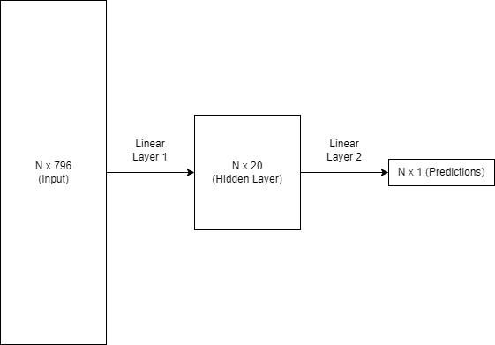
Neural Network Architecture
Double linear layer model with the ability to retain old weight values, if needed.

Slide 10
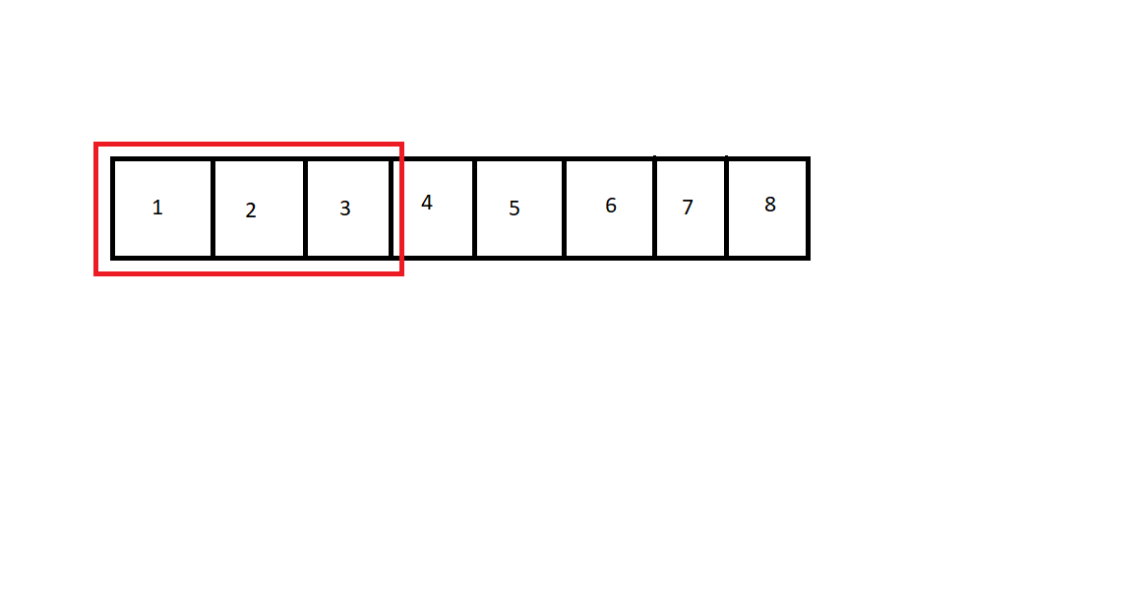
Neural Network Architecture
Double linear layer model with the ability to retain old weight values, if needed.
Retrains for every running window of input.

Slide 11
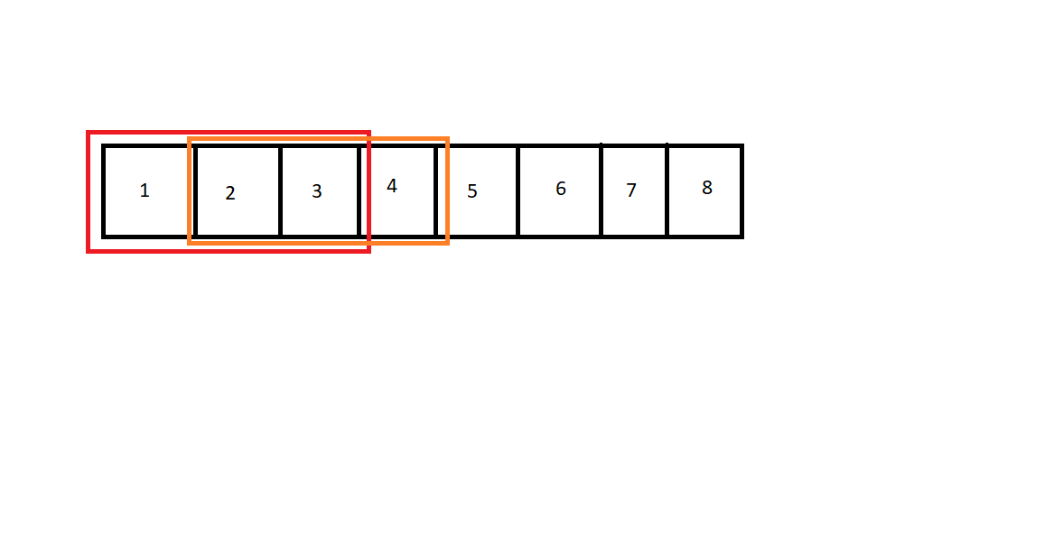
Neural Network Architecture
Double linear layer model with the ability to retain old weight values, if needed.
Retrains for every running window of input.

Slide 12
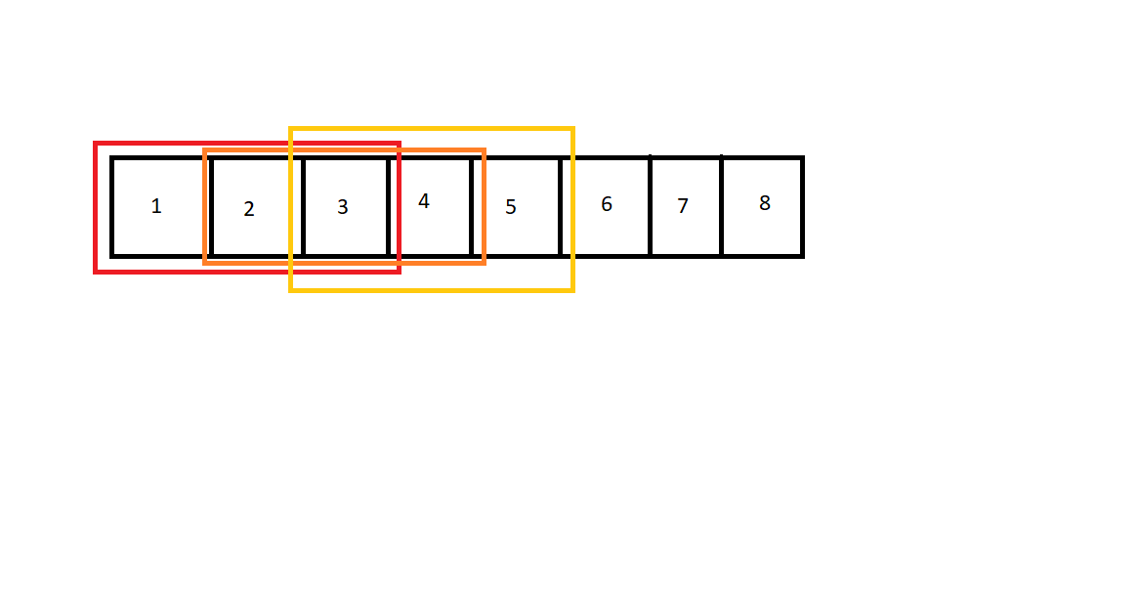
Neural Network Architecture
Double linear layer model with the ability to retain old weight values, if needed.
Retrains for every running window of input.

Slide 13
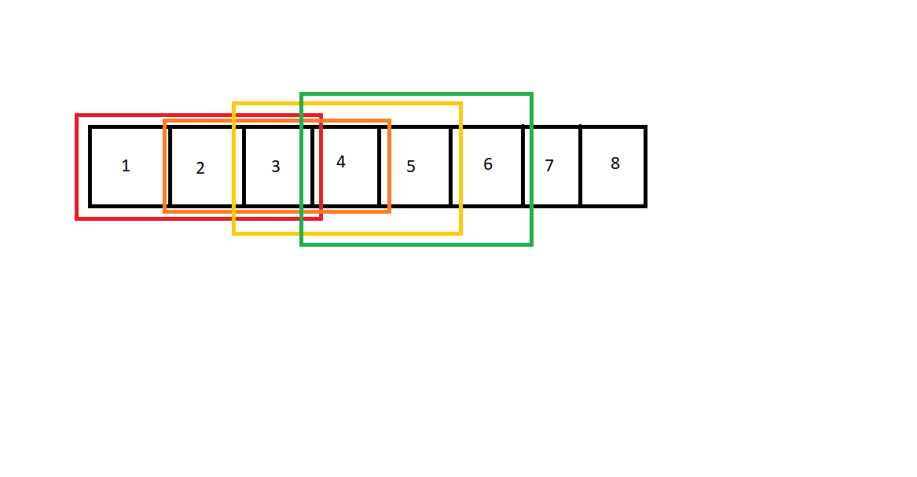
Neural Network Architecture
Double linear layer model with the ability to retain old weight values, if needed.
Retrains for every running window of input.

Slide 14
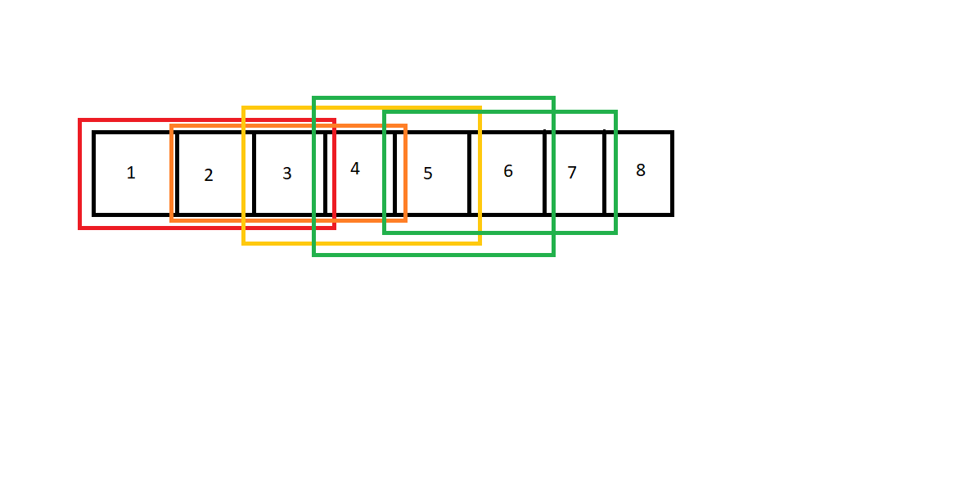
Neural Network Architecture
Double linear layer model with the ability to retain old weight values, if needed.
Retrains for every running window of input.

Slide 15
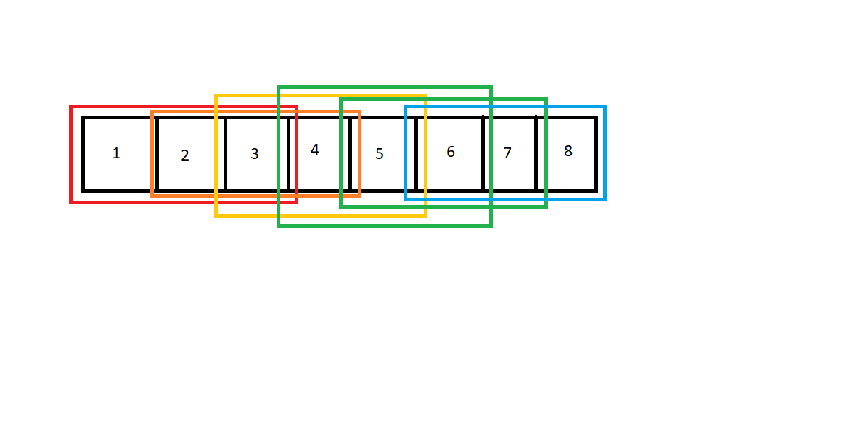
Neural Network Architecture
Double linear layer model with the ability to retain old weight values, if needed.
Retrains for every running window of input.

Slide 16
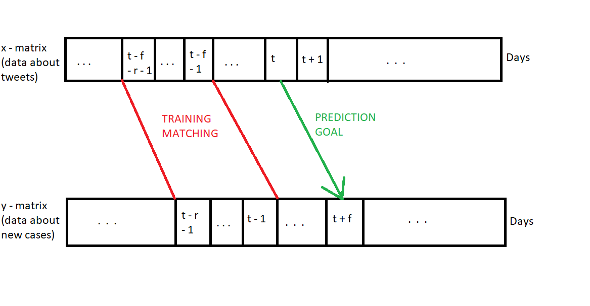
Neural Network Architecture
Double linear layer model with the ability to retain old weight values, if needed.
Retrains for every running window of input.
Offsets target Y by the number of days we want to predict.

Slide 17
Experiment & Results

Slide 18
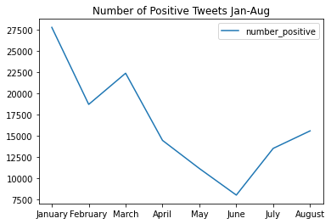
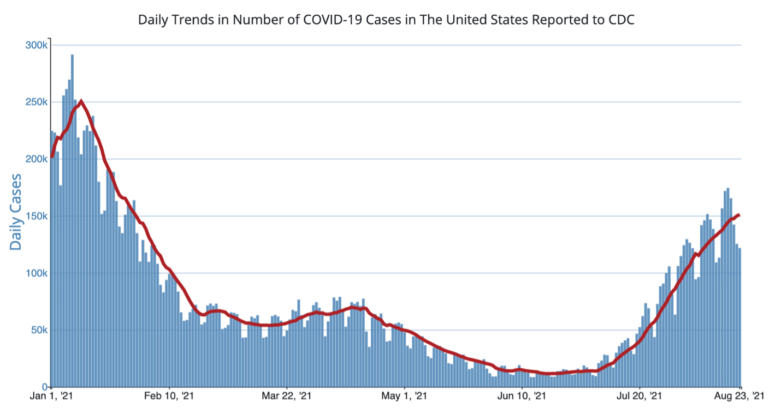
Analysis of Tweet Sentiments
Found that
36% of tweets were Positive
45% of tweets were Neutral
19% of tweets were Negative
Pattern between the number of positive tweets and daily trends in COVID-19 cases

Slide 19
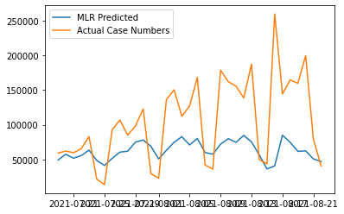
Multi-variable Linear Regression
RMSE Value: 68411
Observe whether we can regress number of cases just from Sentiment information
Large RMSE value
Probably a result of lack of information
Model is unable to predict next day accurately with just aggregated sentiment analysis data

Slide 20
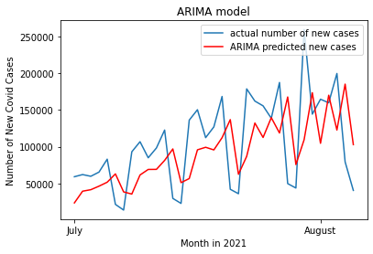
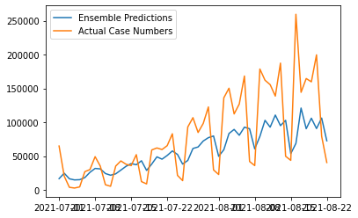
Time Series Models
RMSE Value: 58886
Working with time series dataset, attempted to fit time series models ARIMA, OLS, and ensemble of the two
Arima worked well but had a delay in its predictions, OLS and ensemble did not work well
Arima and OLS do not account for unknown variables
Ensemble of Time series and Regression gets a little better but not much
Probably due to data available

Slide 21
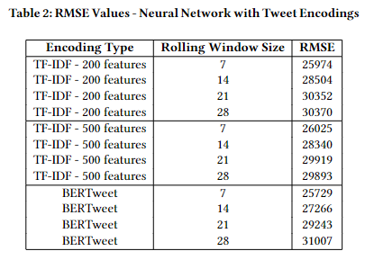
TweetCaster: Neural Network with Tweet Encodings and Metadata
RMSE Value: 25729
Tested to check what embedding and rolling window might be best for the model.

Slide 22
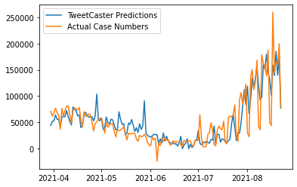
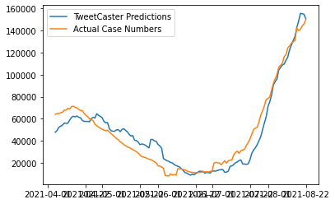
TweetCaster: Neural Network with Tweet Encodings and Metadata
RMSE Value: 25729
Tested to check what embedding might be best for the model.
Trained with rolling window of 7 days to predict 7 days in the future.

Slide 23
TweetCaster: Neural Network with Tweet Encodings and Metadata
RMSE Value: 25729
Tested to check what embedding might be best for the model.
Trained with rolling window of 7 days to predict 7 days in the future.
Achieved decently low RMSE value, beating all the methods tested thus far.
Was able to figure out and follow increment in the number of new COVID-19 cases seven days in advance.

Slide 24
Conclusion & Future Work
Use of Data Science to detect epidemic outbreaks and case spikes
Through the use of Regression and a Neural Network, our project can help keep regional and national officials informed on when a rise in cases might happen
Future Work
Add more training data with more time
Predict new cases for more countries
Predict new cases for regional areas of these countries
Given more RAM, vectorize each tweet instead of aggregating them together by day.

